Slide 1


Group Build
Workshop

Slide 2

WHAT’S THE PROBLEM?
The USD has lost 99% of its purchasing power against Bitcoin in the last decade.

Slide 3

WHAT’S THE Solution?
Give children a head start with sound money. Lightning Piggy makes saving bitcoin fun, visual, and educational.

Slide 4
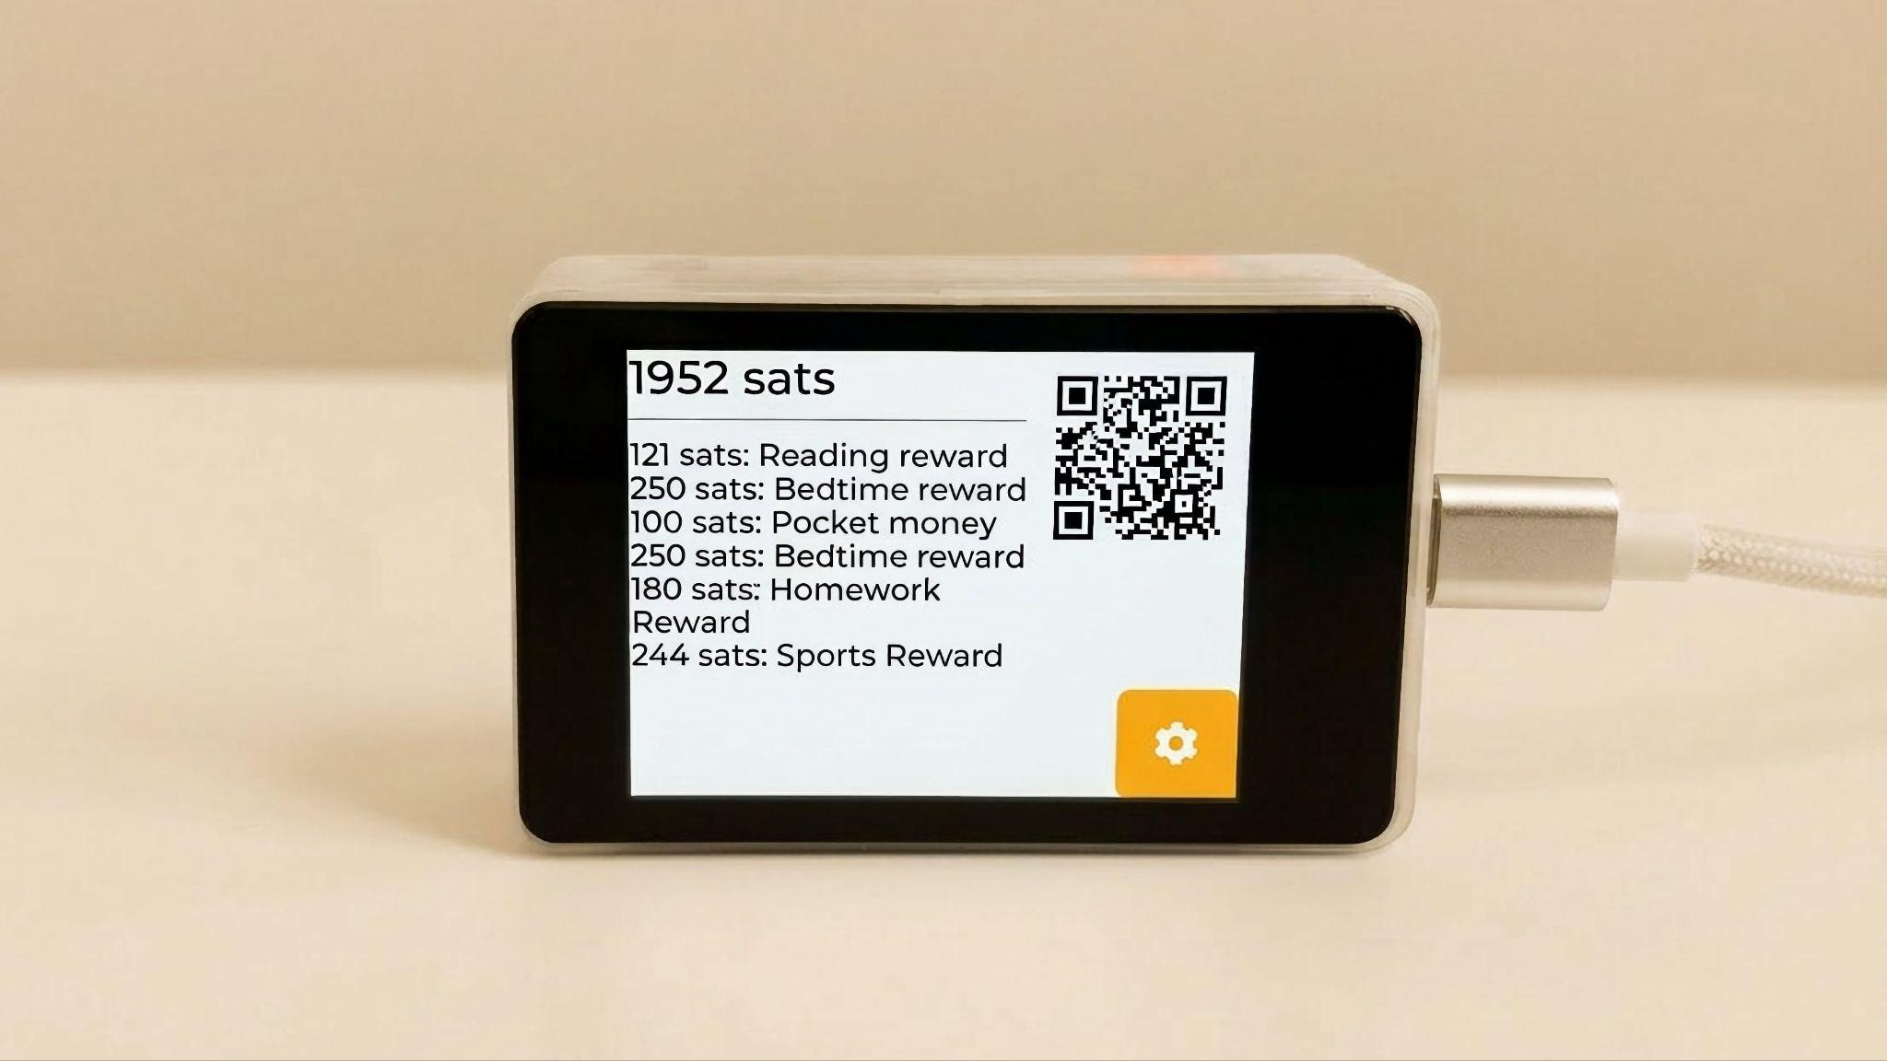
LET’S MAKE SATS THE SAVINGS STANDARD FOR EVERY CHILD!
Lightning Piggy p1 - ZapBox! edition

Slide 5
Time to Build Together
Welcome & Project Overview
Hands-On: Connect to ‘WiFi’ & install the Lightning Piggy 2.0 App!
Follow Along: Creating a Wallet in LNbits
Connecting Your Lightning Piggy to Your LNbits Wallet ⚡️
Let’s Set Up a Nostr Wallet Connect (NWC) Wallet
Pairing Your Piggy with Your NWC Wallet ⚡️
Wrap-Up, Q&A, and Feedback

Slide 6
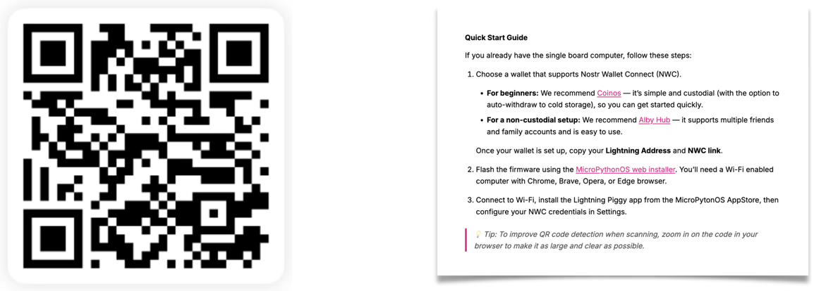
Let’s Follow the Quick Start Guide
https://lightningpiggy.com/build/
Then select your piggy.

Slide 7
Tons of Features
• Simple, low cost device with no subscription fees.
• Lightning-native: instant, low-cost, permissionless Bitcoin payments.
• Receive sats easily via an onscreen QR code.
• Track savings: view satoshi balance, recent transactions, and messages.
• Real-time updates: balances refresh automatically when new payments arrive.
• Flexible wallet backend: choose your own self-custodial setup, or connect in seconds with well known lightning wallet providers.
• Low power consumption - can be battery or solar powered.
• Simple & intuitive - designed for kids aged 4-100.
• Browser-based installer for easy setup and installation.
• Free & open source as standard.
• Self-build options for makers.
• Community powered: supported by a thriving global builder community.
• Built with love by bitcoiners, for the next generation of bitcoiners.

Slide 8
Tons of Features
Kid Friendly Sat Earning & Saving Opportunities
• Receive Bitcoin instantly: simply share an onscreen pay QR.
• Printable QR codes for choirs, rewards, homework, goals, achievements, and visual reminders.
• Optional reoccurring pocket-money payments.
• Auto-swap savings thresholds from Lightning to on-chain.
STEMM Learning Opportunities
• Beginner-friendly open-source codebase: MicroPython based OS and app introduced in LightingPiggy 2.0.
• DIY enclosures: Make your own enclosure using card, cardboard, LEGO, repurposed objects, or 3D print / laser cut a custom housing.

Slide 9
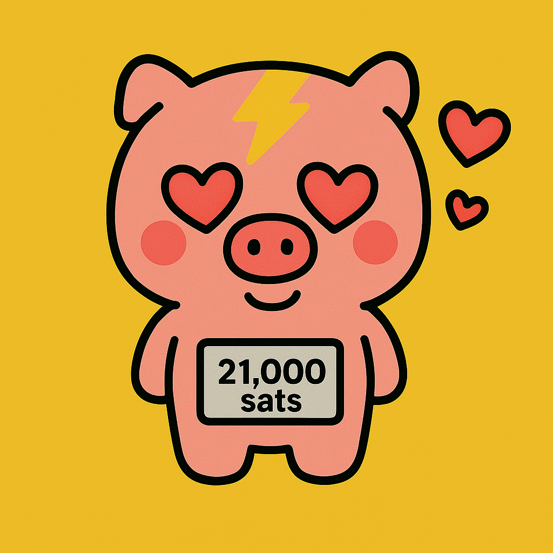
LET THERE BE ZAPS!
If everything went smoothly, you should now be able to receive ZAPS!
Thank you for participating in this workshop.
For more information and ideas please visit LightningPiggy.com

Slide 10


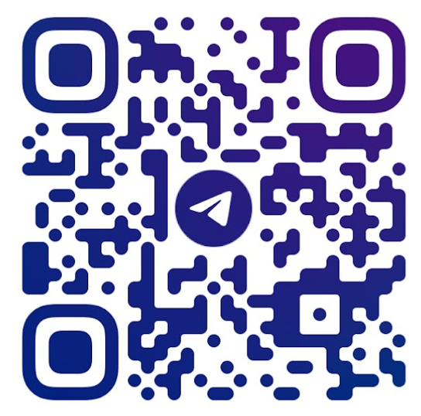
NOSTR
Telegram

Slide 11
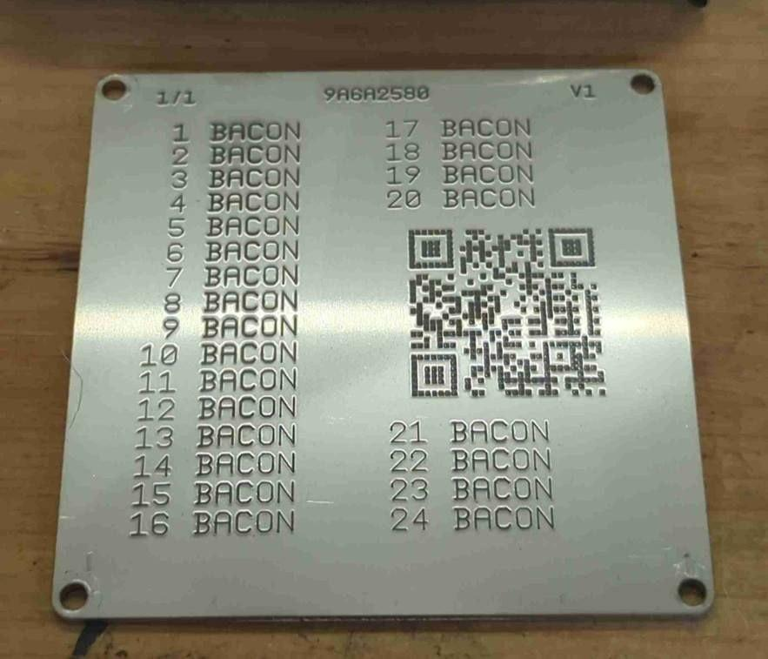
Fun Fact…
🥓 Bacon written 24 times is a valid seed phrase 🥓

